Slide 1
PLUGIN API
by examples
gambry
DrupalCamp London
4th March 2018

Slide 2

ABOUT ME
Hi, I’m:
Gabriele / Gabi / gambry
15+ PHP / 10+ Drupal
Lead Drupal Engineer/Consultant @ MANIFESTO
I Like:
Drupal, PHP, Javascript, Deployment, Performance
Chatbots and Personal Assistants, Encryption
Altered Carbon

Slide 3

BY EXAMPLES
THE QUICKEST WAY
TO THE DARK SIDE
Notes:
Examples are dangerous
Go home and check the code
Open your project and start using Plugin API
All session is about examples, but don’t threat this as a Stack Overflow bucket, you can copy and paste. Make it your own!

Slide 4

ENTITY
Same model, different data
Notes:
Node/Content, Configuration, Menu items
Not – easily – reusable across projects
Not meant to be extendible

Slide 5
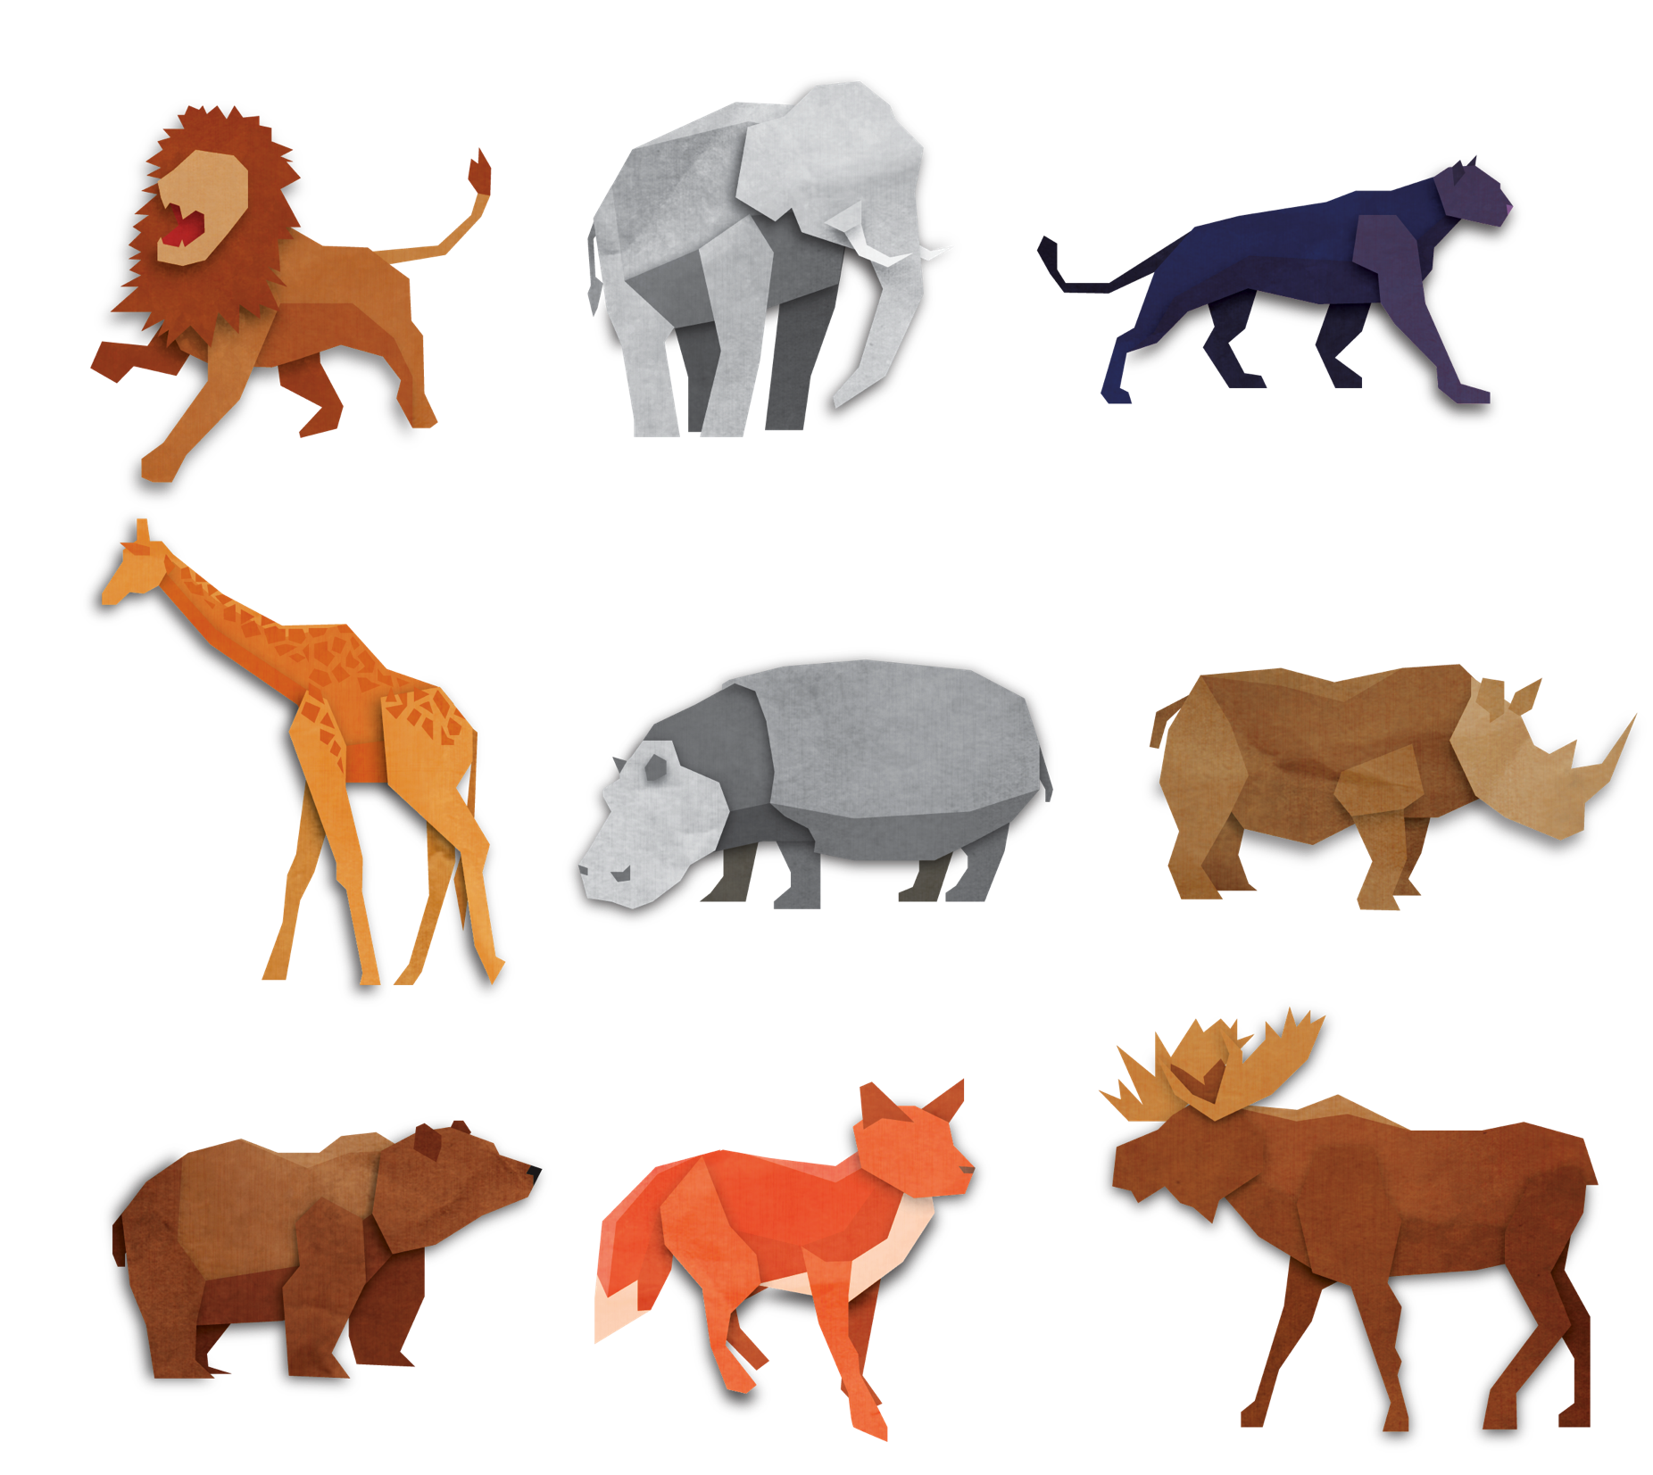
PLUGIN
Same “thing” type, different ways
Notes:
OO way. In D7 they were mainly hooks/hook_info
Organised Structure
Easily Reusable across projects
Extendible (no copy and paste)

Slide 6
PLUGIN TYPES IN DRUPAL CORE
Form elements, for fields values input
Field Formatters
Field Widgets
Block
Migration Source
Migration Destination
Field types, Entity types, Mail back-ends, Conditions, Views filters, Views arguments, and many more…
Html elements, for fields values output
Html blocks, for miscellaneous usage
Different SOURCES to get the data FROM
Different DESTINATIONS to store the data TO

Slide 7

cheapadvisor
Brief : Our Start-up needs a system like TripAdvisor
Budget : £ 200
Deadline: Yesterday
Notes:
How can we do that????

Slide 8
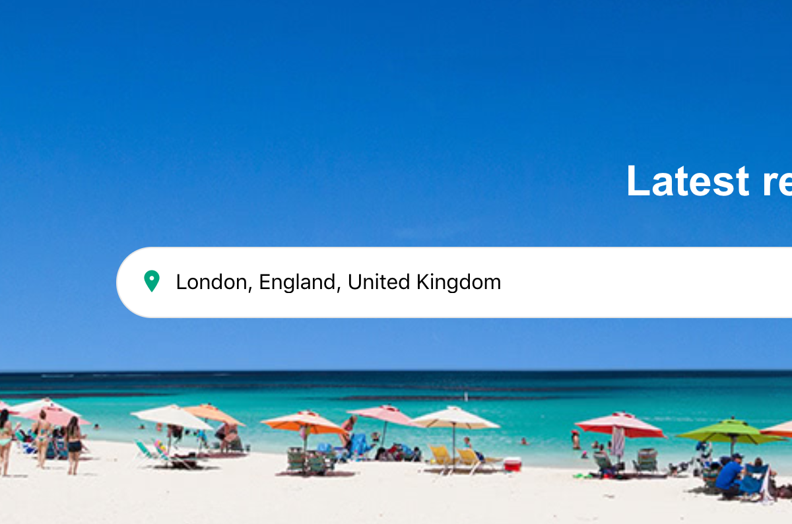

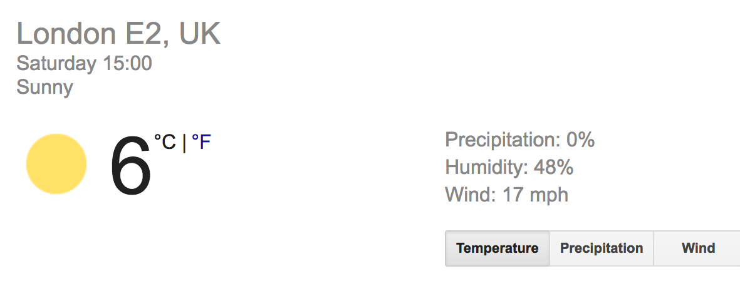
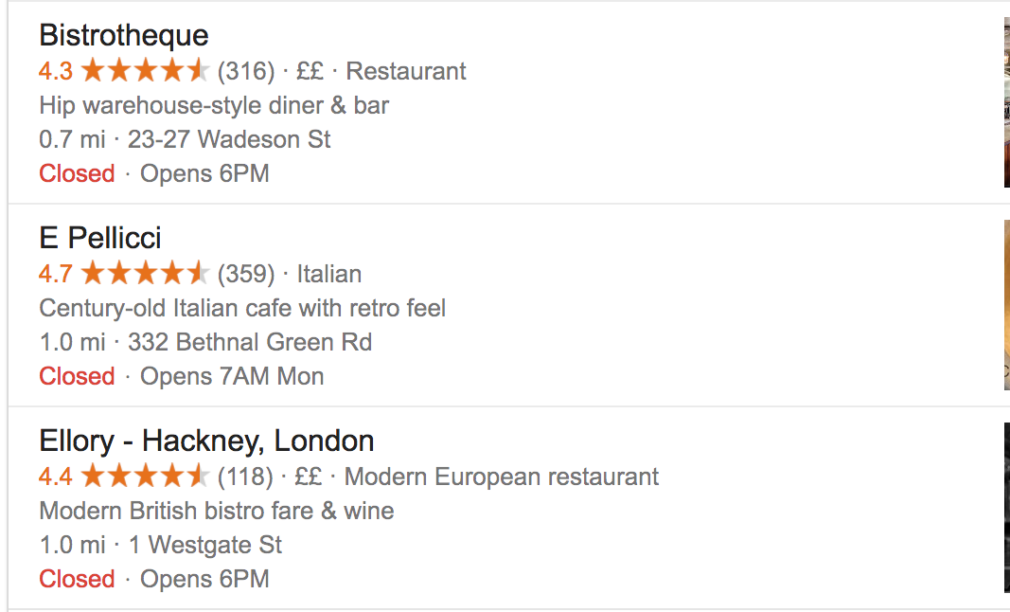
PLUGIN API
AT THE RESCUE!

Slide 9

PLUGIN TYPE
CityWidget
Its plugins:
Receive a city name as argument
Build widgets with info about the city
Notes:
PHP, OOP.

Slide 10
INTERFACE
/**
* Defines an interface for City widget plugins.
*/
interface CityWidgetInterface extends PluginInspectionInterface {
/**
* Returns the render-able widget for provided city
*
* @param string $city
* The name of the city to build the widget for.
*
* @return array
* The render-able array.
*/
public function buildWidget($city);
}
Build the widget, from the city

Slide 11

PLUGIN MANAGER
Service responsible for defining how to:
Find CityWidget plugins (Discovery)
Create instances of the plugin (Factory)
Manage other aspect of our plugin type
Notes:
Lazy loaded

Slide 12

PLUGIN DISCOVERY
Finds your CityWidget plugins
Finds “Derivatives”, dynamically run-time defined CityWidget plugins
Methods: Annotation, Yaml
Other methods: hook, static, your own

Slide 13

PLUGIN FACTORY
PHP Factory pattern
LazyLoad: From plugin ID To Plugin object
Method: DefaultFactory, ContainerFactory, ReflectionFactory
Notes:
Mapper OR custom factory logic on ::getInstance() (i.e. mail system, formatter plugin defaulting to default_formatter)

Slide 14

DON’T PANIC
You are not alone!
Drupal Core
Drupal Console

Slide 15
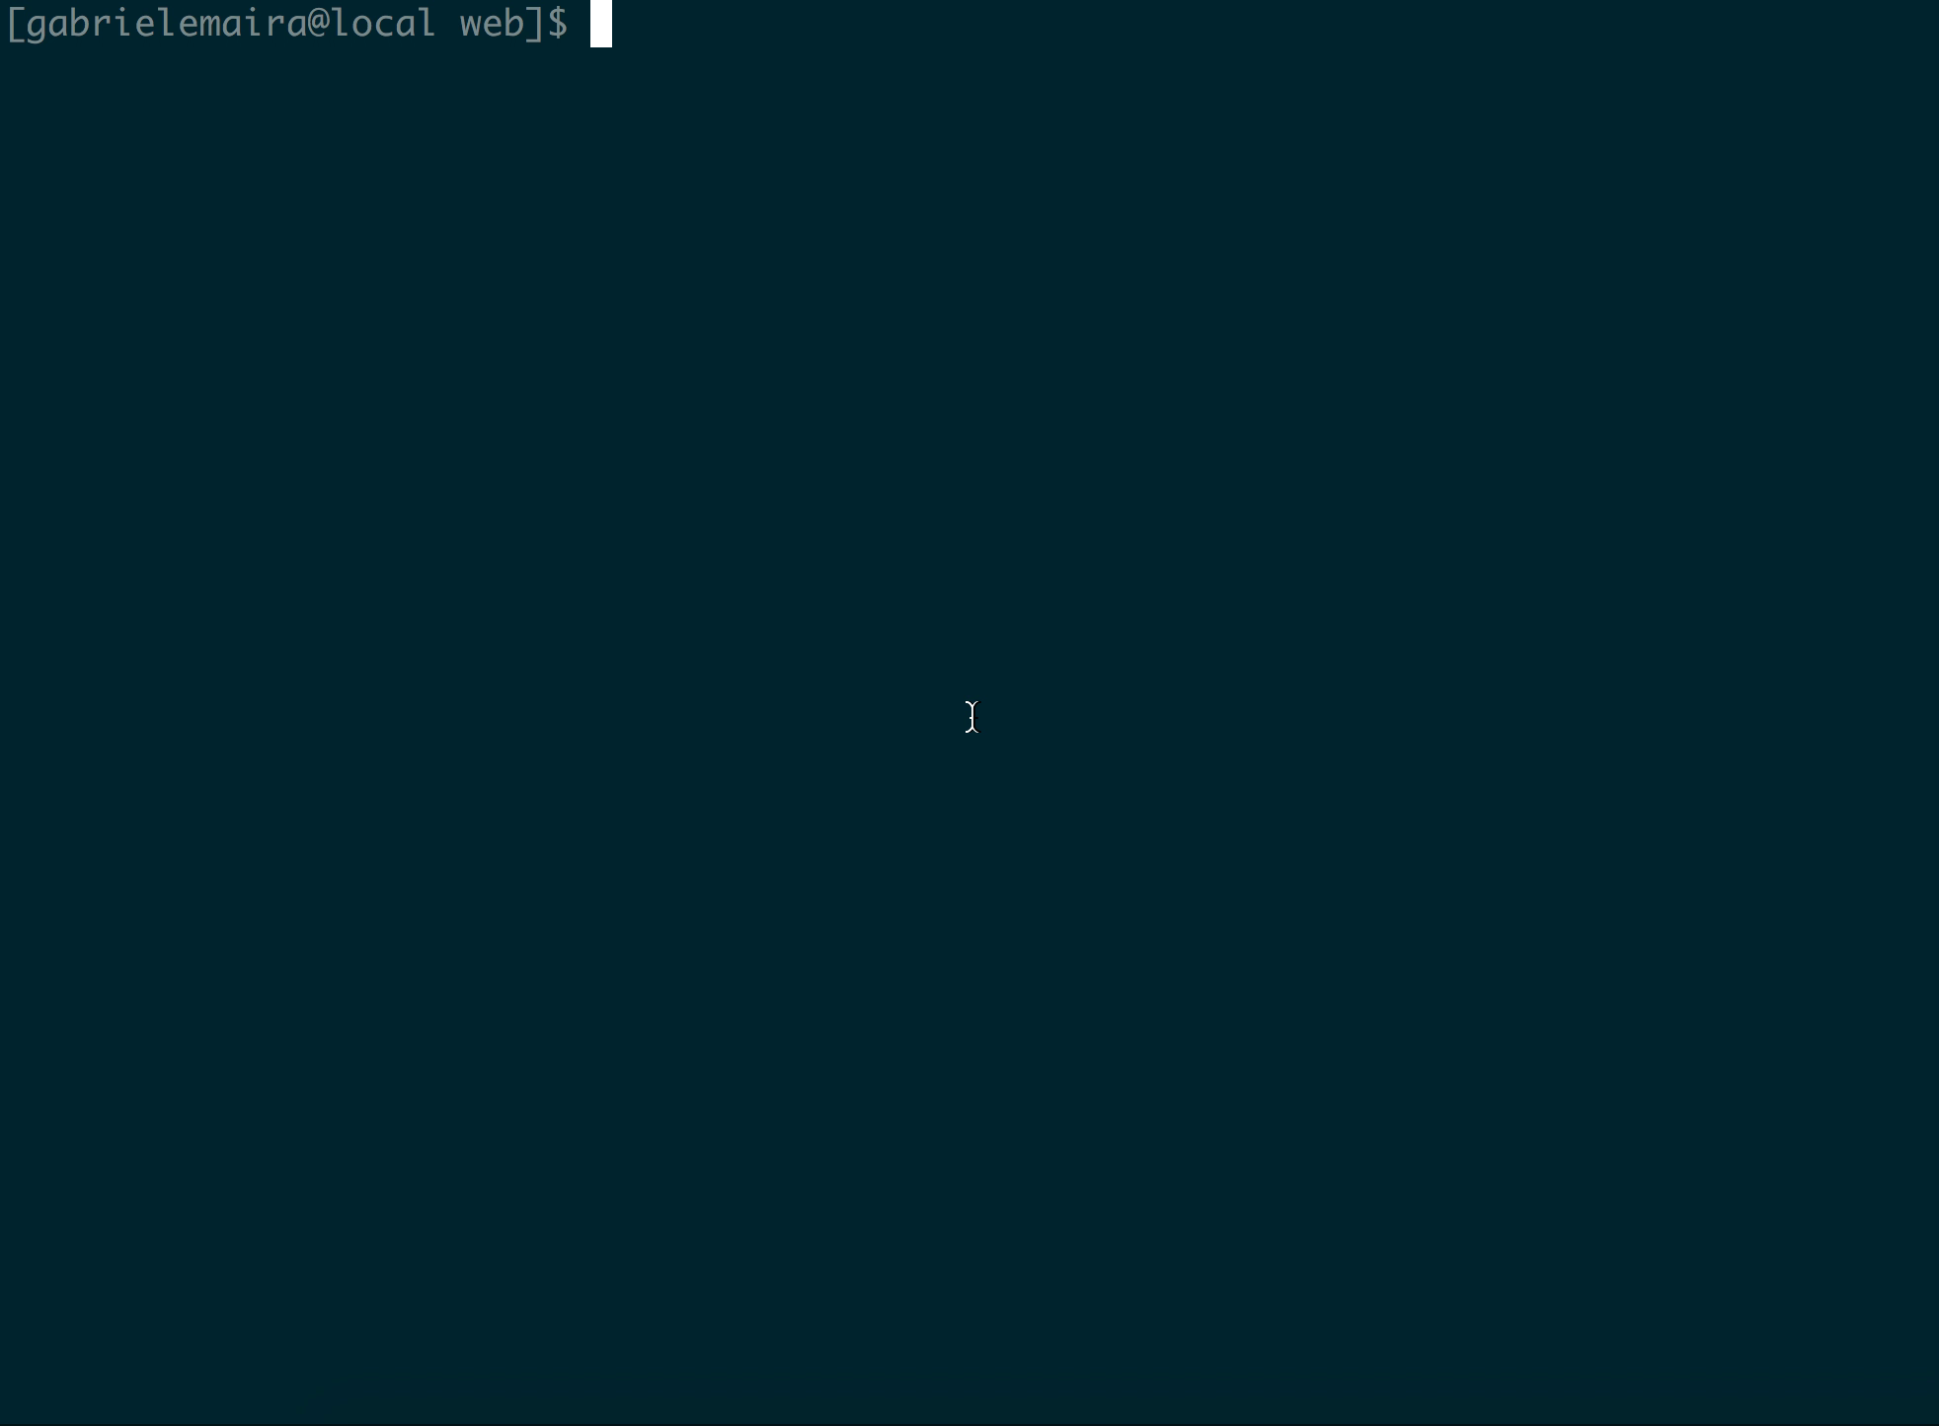
GENERATE YOUR PLUGIN TYPE

Slide 16
GENERATE YOUR PLUGIN TYPE
drupal generate:module
drupal generate:plugin:type:annotation
/modules/custom/cheap_advisor/cheap_advisor.info.yml
/modules/custom/cheap_advisor/cheap_advisor.module
/modules/custom/cheap_advisor/src/Annotation/CityWidget.php
/modules/custom/cheap_advisor/src/Plugin/CityWidgetBase.php
/modules/custom/cheap_advisor/src/Plugin/CityWidgetInterface.php
/modules/custom/cheap_advisor/src/Plugin/CityWidgetManager.php
/modules/custom/cheap_advisor/cheap_advisor.services.yml

Slide 17
Weather Forecast
List of restaurants

Slide 18
FORECAST
/**
* Provides a weather forecast CityWidget plugin. * * @CityWidget( * id = "weather_forecast", * label = @Translation("Weather Forecast") * )
*/
class WeatherForecast extends CityWidgetBase {
/**
* {@inheritdoc}
*/
public function buildWidget($city) {
return [
'#theme' => 'city_widget_weather_forecast',
'#forecast' => \Drupal::service('cheap_advisor.weather_forecast')->getFromCity($city),
];
}
}
Plugin annotation definition
Plugin logic
src/Plugin/CityWidget/WeatherForecast.php

Slide 19
RESTAURANTS
/**
* Provides a weather forecast CityWidget plugin. * * @CityWidget( * id = ”restaurants", * label = @Translation(“Restaurants") * )
*/
class Restaurants extends CityWidgetBase {
/**
* {@inheritdoc}
*/
public function buildWidget($city) {
return [
'#theme' => 'city_widget_restaurantst',
'#restaurants' => \Drupal::service('cheap_advisor.restaurants')->getFromCity($city),
];
}
}
src/Plugin/CityWidget/Restaurants.php

Slide 20
IFRAMEs
cheapadvisor
http://www.google.com/?q=Cool+Things+in+London
http://tourism.biz/cities/London
http://aroundtheworld.whatever/visit/London
http://coolthings.to.do/places/London
http://cheap.local/London
http://hotels.com/London
http://trivago.com/London
…
Notes:
How can we do that????

Slide 21
IFRAMEs (derivatives)
/**
* Provides a base CityWidget plugin for iframes derivatives.
*
* @CityWidget(
* id = "iframes",
* label = @Translation("Iframes"),
* deriver = "Drupal\cheap_advisor\Plugin\Derivative\Iframes"
* )
*/
class Iframes extends CityWidgetBase {
/**
* {@inheritdoc}
*/
public function buildWidget($city) {
$url = $this->pluginDefinition['iframe_url'];
return [
'#markup' => ’<iframe src=“’ . $url . $city . ‘”/>',
];
}
}
/**
* CityWidget Iframes plugin deriver.
*
* @see \Drupal\cheap_advisor\Plugin\CityWidget\Iframes
*/
class Iframes extends DeriverBase {
/**
* {@inheritdoc}
*/
public function getDerivativeDefinitions($base_plugin_definition) {
// Here your logic to load dynamic URLs.
$urls = […];
foreach ($urls as $name => $iframe_url) {
$this->derivatives['iframe:' . $name] = $base_plugin_definition;
$this->derivatives['iframe:' . $name]['label'] = ucfirst($name);
$this->derivatives['iframe:' . $name]['iframe_url'] = $iframe_url;
}
return $this->derivatives;
}
}
Base plugin
Deriver
src/Plugin/CityWidget/Iframes.php
src/Plugin/Derivative/Iframes.php

Slide 22
HOW TO USE IT
/**
* Build the City page content.
*
* @param string $city
* The city, as passed by the request.
*
* @return array
* Return city page content render-able array.
*/
public function pageContent($city) {
$output = [];
/** @var \Drupal\cheap_advisor\Plugin\CityWidgetInterface $widget */
foreach ($this->pluginManagerCityWidget->getDefinitions() as $widget) {
$output[$widget->getPluginId()] = $widget->buildWidget($city);
}
return $output;
}
}
Controller for
route /city/{city}

Slide 23

cheapadvisor
Notes:
How can we do that????

Slide 24


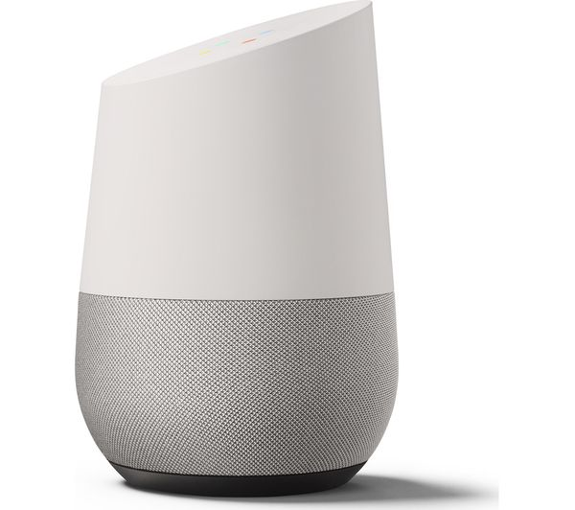



CHATBOT API

Slide 25

Same “thing”, in different ways.
THANK YOU!
drupal.org/docs/8/api/plugin-api @gambry LONDON DRUPAL USER GROUP meetup.com/London-Drupal-User-Group/

